Slide 1
Fitness 101
Mariel Wenzel B.S Physical Education, GA Exercise Physiology
Ray Peralta B.S Exercise Science, GA Exercise Physiology
Adelphi University
Garden City, NY 11530

Slide 2
Why is fitness important to you?
You'll have more energy, strength and stamina.
You'll get sick less often
You'll keep your mind sharp
More likely to stay active later in life
You'll improve your mood
You'll keep your bones strong
Prevention of Heart Disease

Slide 3
Aerobic conditioning helps the heart become stronger
TRUE

Slide 4
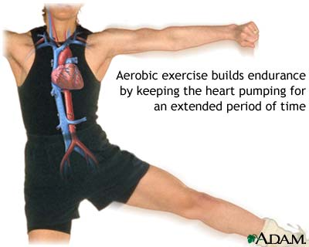
Aerobic conditioning helps the heart become stronger
The heart is a MUSCLE of the human body
strengthen the muscles involved in breathing
help to pump more blood
improve circulation

Slide 5
If you stop exercising, your muscles will turn into fat
FALSE

Slide 6
IF YOU STOP EXERCISING YOUR MUSCLES WILL NOT TURN INTO FAT
Hypertrophy vs. atrophy
Possible weight gain if the exercise diet does not change.
FAT IS FAT and MUSCLE IS MUSCLE.

Slide 7
SWEATING IS BAD
FALSE

Slide 8
SWEATING IS GOOD!
How your body stays cool!
Heat is released by the body and body temperature rises.
More sweat glands are activated during puberty
Exercise intensity plays a role
Replenish the water lost during exercise

Slide 9
Doing crunches and abdominal workouts will help reduce belly fat
FALSE

Slide 10
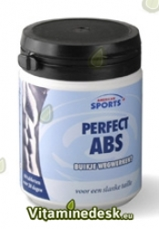
There is no such thing as spot reduction!
Fat is lost throughout the body
Overall body fat must be reduced to lose fat in any particular area.
Muscular exercises will only exercise the muscles under the fat.
The media makes it seem like we can spot reduce!

Slide 11
You should always use a spotter with free weight strength training exercises
TRUE

Slide 12
Spotting during weight training
Spotters are essential to help you:
  motivation
  help you manage equipment
  support system
  SAFETY
  Think safety for younger kids and gym equipment size!

Slide 13
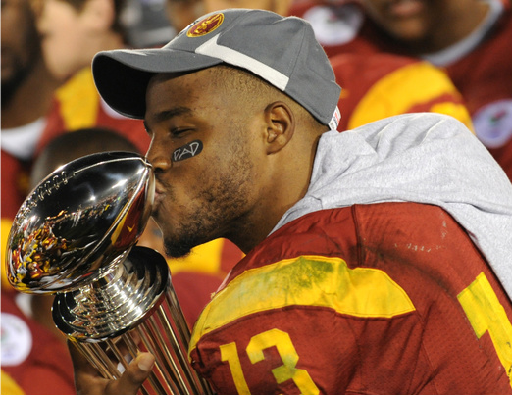
Stefan Johnson
University of Southern California tailback, Stefan Johnson had a horrific accident while weight-lifting. Most of Johnson's throat was crushed when the weight fell. Doctors described Johnson's neck as being "mostly flat" as a result of his injury.
Stefan Johnson lost control of a weight bar he was bench-pressing, and the weight came down on his throat. Stefan Johnson suffered a crushed neck, including the larynx, and endured more than seven hours of surgery to reconstruct his neck structure.

Slide 14
Being active means playing sports
FALSE

Slide 15
You don’t need to play sports to be physically active
Walk instead of taking the car a short distance
Walk the dog instead of watching TV
Use stairs instead of the elevator or escalators
Dance
Ride your bike
Exergaming
Find something that interests YOU!

Slide 16
WEIGHT LIFTING IS ONLY FOR GETTING BIGGER MUSCLES
FALSE

Slide 17
WEIGHT LIFTING benefits
Help you perform everyday activities
Less likely to be injured.
Weight lifting=increased body mass
Increased body mass= increased metabolism
OBESITY=BIG PROBLEM
Improve your balance and posture!
Develop strong bones

Slide 18
PACKET b

Slide 19
Running is counter productive to strength training
FALSE

Slide 20
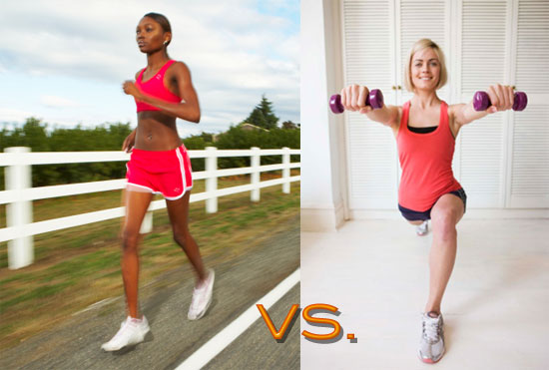
CARDIOVASCULAR ACTIVITIES AND STRENGTH TRAINING WORK TOGETHER
Aerobic workouts + strength training = well balanced fitness
Aerobic fitness = good cardiovascular health
Strength training =
Lean Body Mass
Bone Mineral Density

Slide 21
Running is better than biking
FALSE

Slide 22
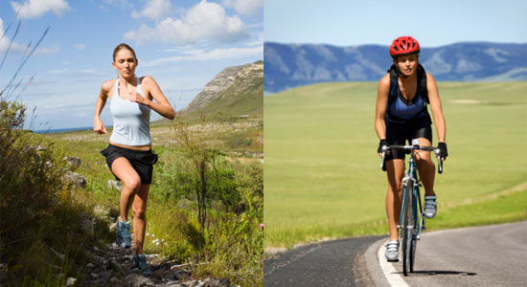
Biking and running are great forms of physical activity
Burn Calories = decrease risk of obesity
Find something YOU enjoy!
Ask children what they like to do in their spare time, work with what they like to do

Slide 23
Temperature can be a safety issue when exercising
TRUE

Slide 24
EXTREME WEATHER EXERCISE SAFETY
PREVENTION
COLD CONDITIONS can be dangerous
Shivering
Frostbite
Hypothermia
Layer Clothing
Cover your Head
Stay Dry

Slide 25
Extreme weather exercise safety
HOT CONDITIONS can be dangerous
PREVENTION
Dehydration
Sunburn
Heat cramps
Heat rash
Heat exhaustion
Heat stroke
Drink the Right Amount of the Right Fluids
Replace Lost Electrolytes
Wear Appropriate Clothing
Use Sunscreen and Avoid Sunburn
Use Common Sense

Slide 26
LIFTING WEIGHTS WILL CAUSE OUR BODIES TO LOOK BULKY
FALSE

Slide 27
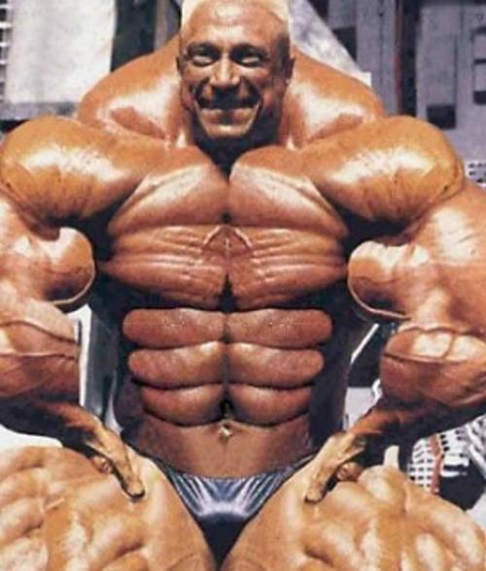
MUSCLE BULK
Testosterone
Women have very low levels of this hormone
Men > Testosterone than women

Slide 28
Everyone has similar body shapes
FALSE

Slide 29
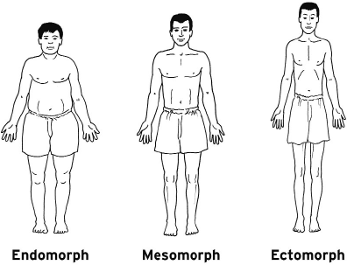
somatotypes
Genetically determined
Three types: endomorph, mesomorph or endomorph
Combinations of the three
Find exercises / sports that are best suited for you.
Start by loving YOUR BODY and making conscious choices that keep it healthy.

Slide 30
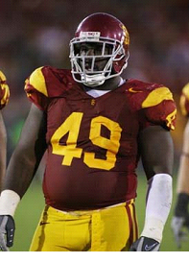
Endomorph
A pear shaped
Wide hips and shoulders
Wider front to back rather than side to side.
A lot of fat on the body, upper arms and thighs
Gain weight easily and lose condition quickly if training stops.
Sports of pure strength, like power lifting, are perfect for an endomorph

Slide 31
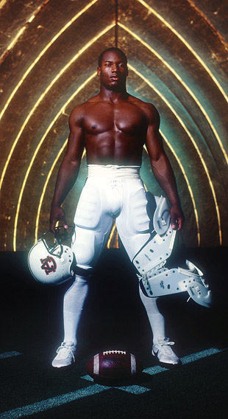
Mesomorph
Wide broad shoulders
Muscled arms and legs
Narrow from front to back rather than side to side.
A minimum amount of fat
Find it easy to lose and gain weight.
A mesomorphic individual excels in strength, agility, and speed activities

Slide 32
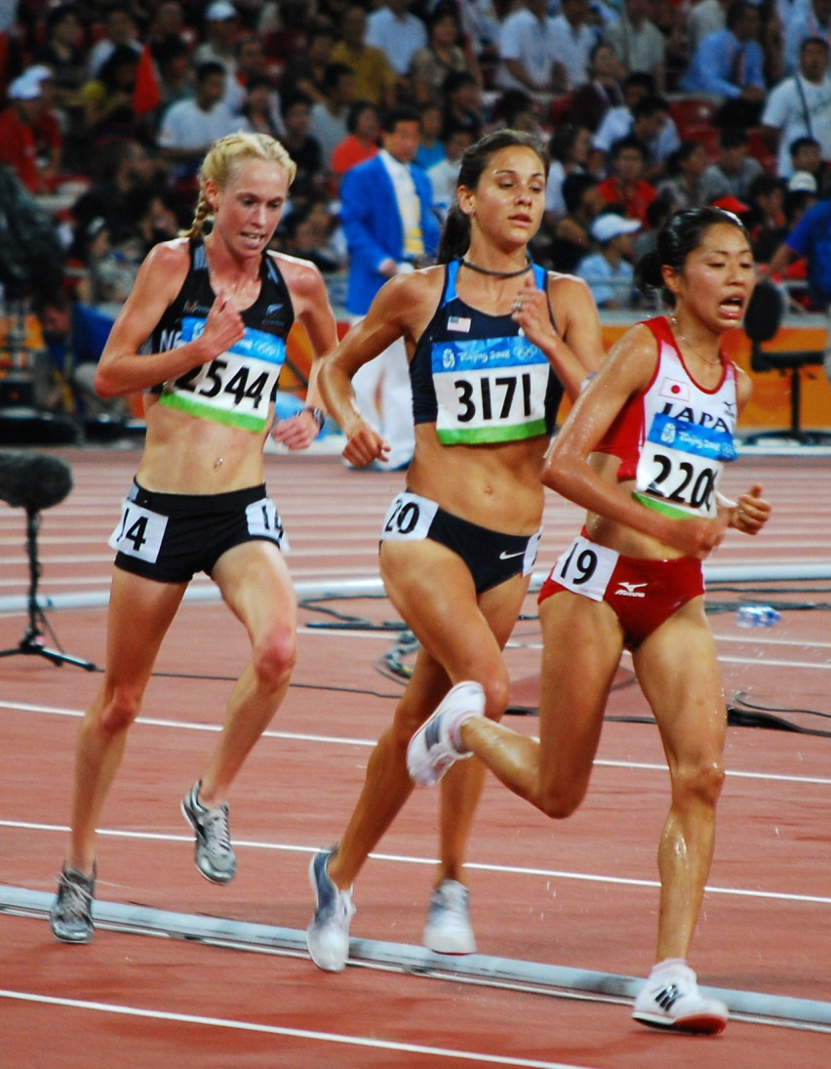
ectomorph
Narrow shoulders and hips
A narrow chest and abdomen
Thin arms and legs
Little muscle and fat
Light frame makes them suited for aerobic activity like cross-country running.

Slide 33
Weight-bearing activities are not good for CHILDREN
FALSE

Slide 34
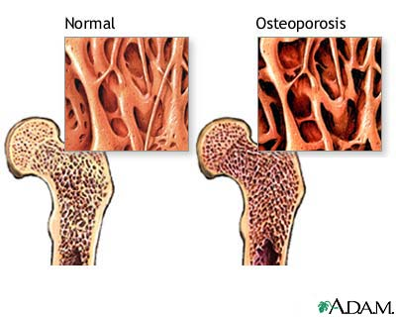
Prevention of osteoporosis
Weight bearing activities are most important during the pre-puberty years
Weight bearing activities may include:
  Walking
  Running
  Stair-climbing
  Resistance exercise

Slide 35
Warming up Prior and cooling down After exercise is important
TRUE

Slide 36
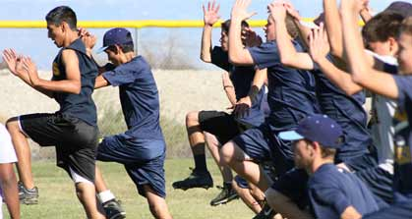
Warm-up
Light cardiovascular activity
  Warm the core temperature
  Contraction and relaxation of muscle
Dynamic stretching
  Stretch muscle when it is warm
  Stretching cold muscle increases chance of injury

Slide 37
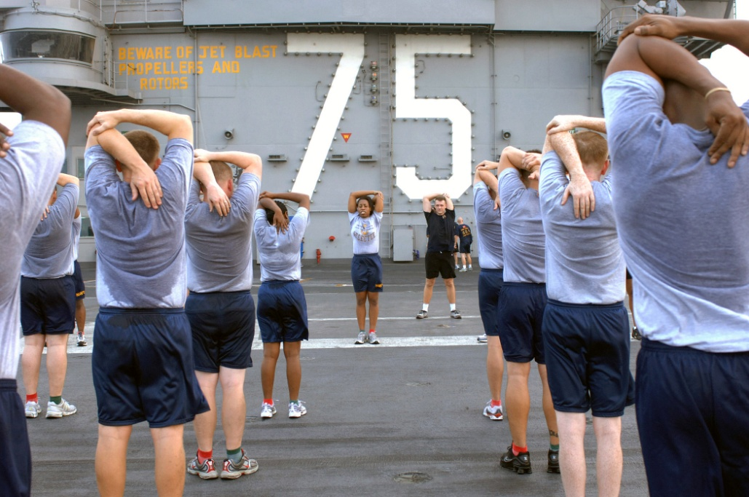
Cool down
Light aerobic activity
  Reduce blood pooling
  Reduce adrenaline
  Bring down heart rate
  Reduce the chance of light headiness
  Calm down
Static stretching
  Muscles are warm to stretch and flexibility may improve

Slide 38
QUESTIONS?
Contact Information:
E-Mail: Mwenzel@adelphi.edu
E-Mail: Rperalta@adelphi.edu

